Slide 1
Module 4: Device Orientation
SER 423

Slide 2
Device Orientation Overview
We usually want to change how elements in our View are displayed depending on how the device is oriented
There are two orientations that apps recognize
The first is portrait orientation, where the device is held up such that the height of the screen is longer than the width
The second is landscape orientation, where the device is held on its side such that the width is longer than the height
Not only does the screen need to rotate when switching between these two options, but we should also consider how things are laid out in our View
We have the same amount of space, but we have to arrange elements differently

Slide 3
The Setup

Slide 4
Getting Things Ready
React does not have any built in functionality for quickly detecting which orientation that device is currently in
Expo does provide a helper library called Dimensions
This library does not tell us the orientation directly, but we can use it to figure it out ourselves
Before we get to our regular scheduled coding, we need to make a change in the app.json file that Expo creates for us when we make a new project
By default, the app will only display in portrait mode
We need to edit this to enable the orientation to change
The orientation value will be “portrait”, we need to change it to “default”

Slide 5
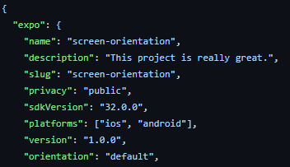
Edits to the App.json File

Slide 6
Implementation

Slide 7
Setting Up the Individual Elements
Following the example from the book, we will create a list of items, so we need to start by designing how the list will look in the different orientations
For this example, the list will only display the titles of the items in the list if the device is in landscape mode
Otherwise, we will only get the icon for each item
For this part, we take the orientation as a parameter, we will figure it out in another place
This part is only concerned with reacting to which orientation we have

Slide 8
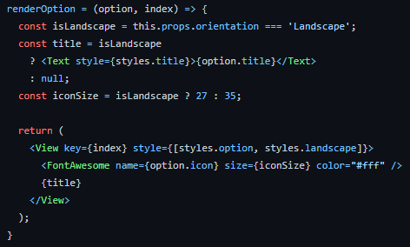
The RenderOption Function

Slide 9
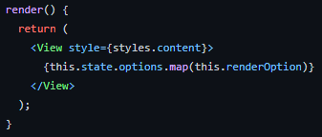
The Render Function

Slide 10
Calculating the Orientation
We can use the DImensions library in our own function to figure out the orientation
The library can tell us the height and width of the screen
This will change when the device is rotated
So: height > width = Portrait, else Landscape
We can then just store this in state for use later
This then makes it easy to determine the orientation at launch
However, how do we know if it changes while the app is running?
First, we can use the componentWillMount lifecycle hook
Second, we can set our View to have an onLayout property to call our function
Together these mean that the orientation will be checked every time the component becomes active, and every time it is rendered

Slide 11
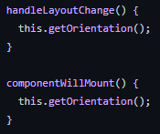
Calling the Function

Slide 12
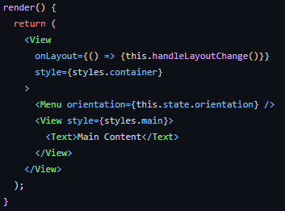
How Render Looks

Slide 13
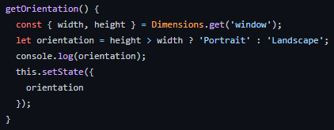
The Actual Function

Slide 14
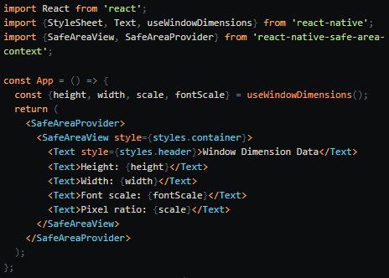
useWindowDimensions Example

Slide 15
End of Device Orientation
Next Time - External Links

